Slide 1
Structured Products Conference
11 September 2019
Daniel Volker
Michal Przybylski, Bloomberg

Slide 2
Structured Products popular on Russian market
Investment products:
Capital protected notes
Reverse convertibles
Autocallables
Credit
Hybrid

Slide 3
Structured Products popular on Russian market
Equity
Basket
Best/Worst
Asians
Memorable
Lookback
Correlation
Quanto
FX
TARFS
IR
Swaptions
Callable swaps
Quanto swaps
Credit
CLNs
CDS
FTB (first-to-default)

Slide 4
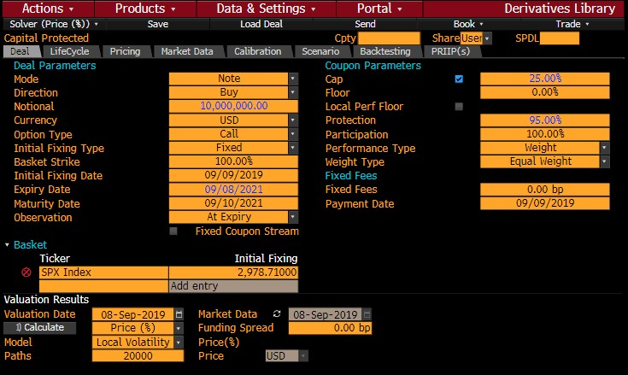
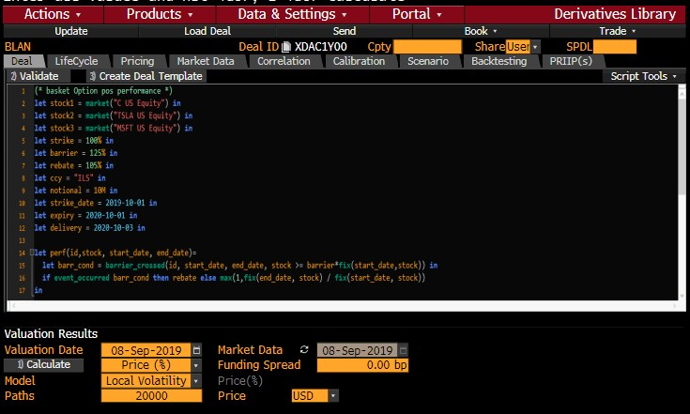
Bloomberg tools to price structured products
  DLIB (Derivatives Library) is a comprehensive platform to:
    Structure
    Price
    Risk Management
    Distribute
  DLIB is based on four interfaces:
    Templates
    Easy scripting language
    User defined templates
    API

Slide 5
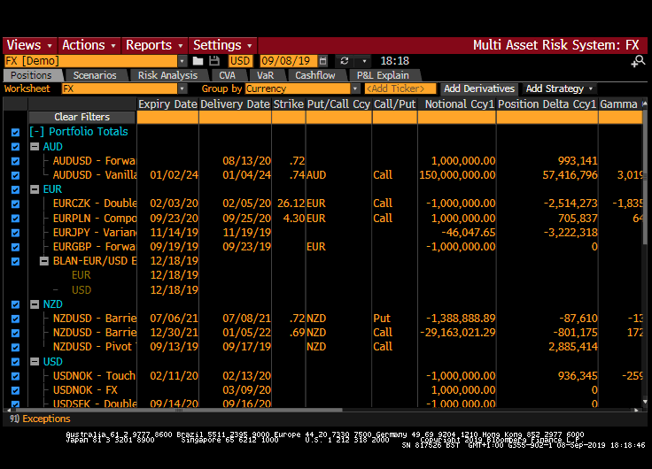
MARS - RISK Management
Mark-to-market, Greeks & P&L Explain
Scenario analysis
& stress testing
Pre-trade-analysis
Lifecycle

Slide 6
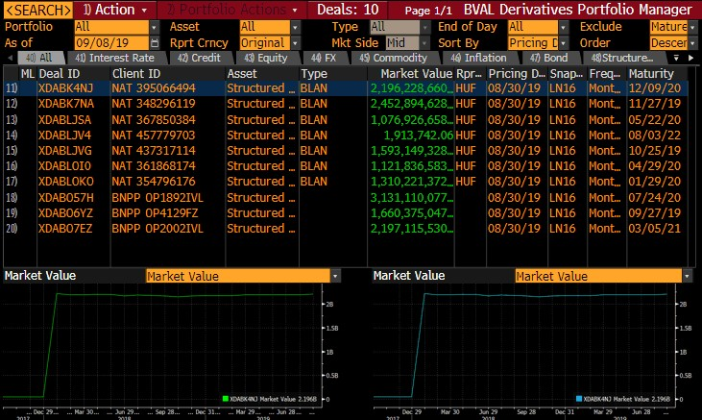
BVAL – Independent valuations for OTC derivatives & structured notes
High-quality data
Unbiased & independent valuation
Data & model transparency
Financial expertise

Slide 7
What is PRIIPS?
The Packaged Retail and Insurance-based Investment Products (PRIIPs) is a European regulation requiring manufacturers to issue a three-page Key Information Document (KID) when selling PRIIPs products to retail investors.
KID main points:
What is the products ?
What are the risks and what I get in return?
What happens if PRIIPS manufacturer is unable to pay out?
How long should I hold it and can I take my money early?
How can I complain?
What are the costs?
Other relevant information

Slide 8
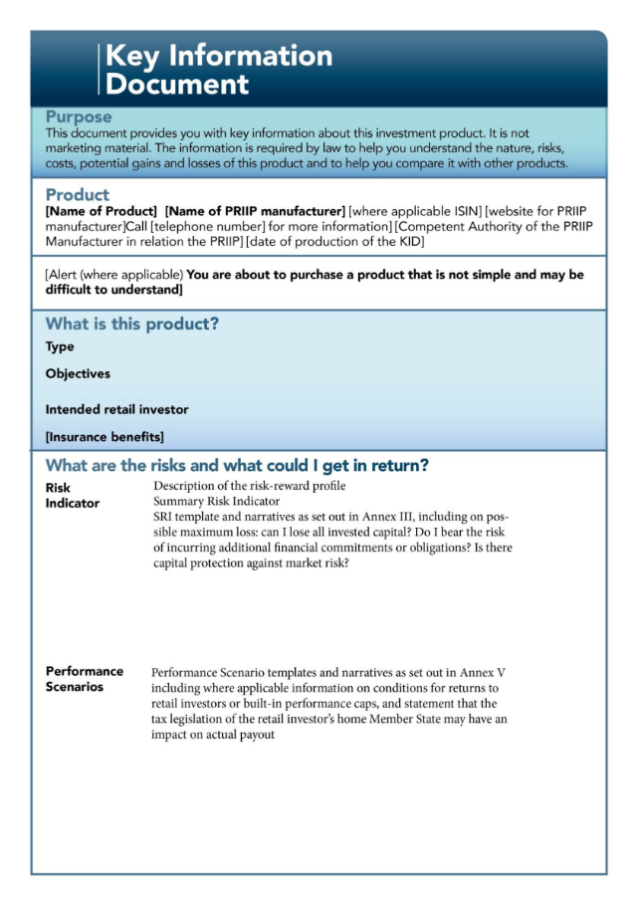
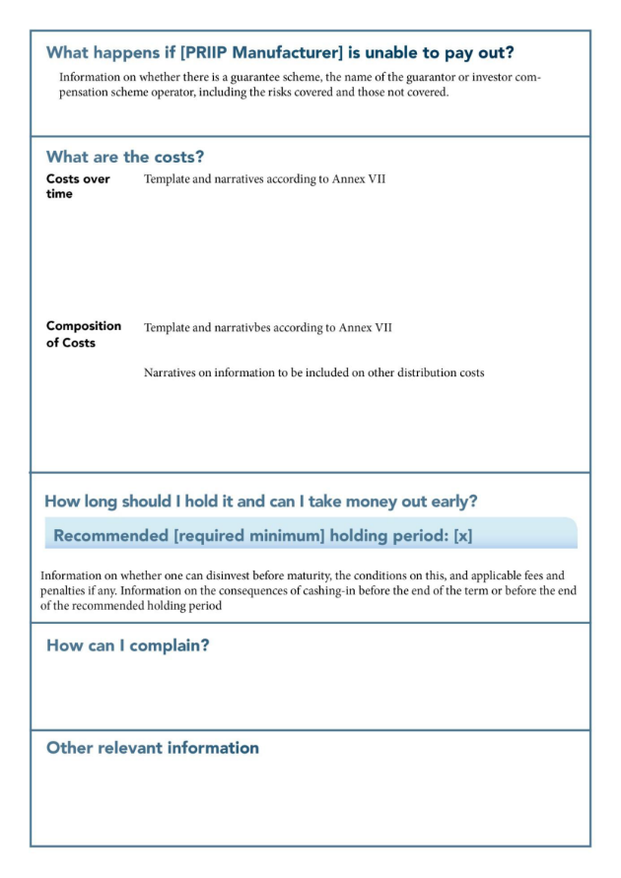
Key Information Document (KID)

Slide 9
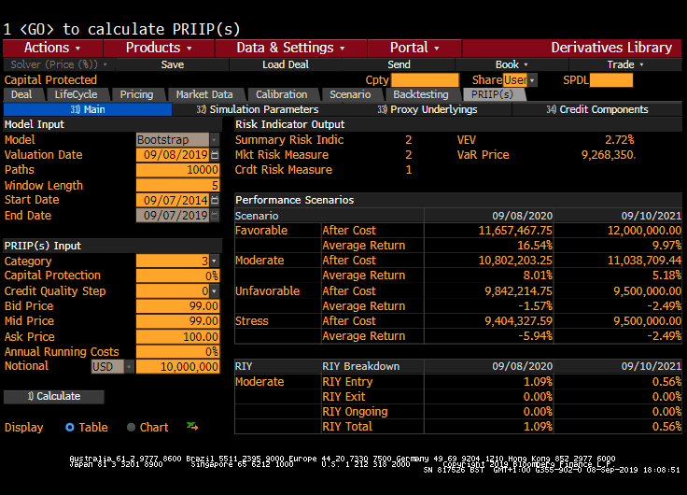
PRIIPS in Bloomberg

